Slide 1


K.RAMAKRISHNAN COLLEGE OF TECHNOLOGY
(AUTONOMOUS), TRICHY
CHAT APPLICATION
PRESENTED BY SUPERVISOR
K.PALANIRAJAN Mrs.K.Valli Priyadharshini M.E., (PhD),
2303811710421113 AP/CSE.

Slide 2
PRESENTATION OVERVIEW
Objective
Project Introduction
Problem Statement
Methodologies (Programming concepts relevant to problem statement)
Architecture of the proposed system
List of Modules
Merits
Results and Discussion
Queries

Slide 3
Objective
To design a Java-based client-server chat application enabling real-time text communication.
To demonstrate core concepts of socket programming, multithreading, and GUI development.
To create a simple, interactive interface for users to exchange messages seamlessly.

Slide 4
Project Introduction
The application facilitates real-time text communication between a client and a server.
Built to demonstrate fundamental networking and GUI design principles.
Enables users to exchange messages interactively through a simple user interface.

Slide 5
Problem Statement
The need for a real-time communication system for exchanging messages between two endpoints.
Existing solutions are often complex, lacking simplicity and basic implementation for educational purposes.
Challenges include maintaining seamless communication, handling concurrent operations, and providing a user-friendly GUI.

Slide 6
Methodologies
Socket Programming: Establishing and managing the connection between the client and server using Socket and ServerSocket classes for real-time message exchange.
Multithreading: Implementing a separate thread to handle incoming and outgoing messages concurrently, ensuring the application remains responsive.
Graphical User Interface GUI: Developing an interactive interface using Java AWT components like TextField, TextArea, and Button to enable users to send and view messages seamlessly.

Slide 7
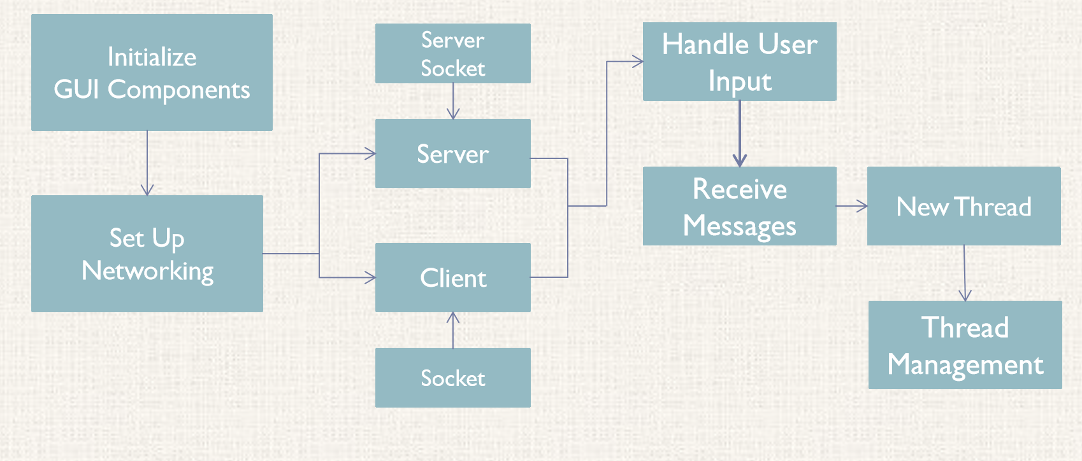
Architecture of the proposed system

Slide 8
List of Modules
Server Module: Handles client connections using ServerSocket and manages incoming and outgoing messages with DataInputStream and DataOutputStream.
Client Module: Connects to the server using Socket and facilitates real-time communication with DataInputStream and DataOutputStream.
GUI Module: Provides an interactive interface for users with TextField for input, TextArea for conversation history, and Button for sending messages.

Slide 9
Merits
Simple and intuitive interface: The GUI ensures ease of use for users to send and receive messages.
Real-time communication: Enables seamless and instantaneous message exchange between client and server.
Educational value: Demonstrates core Java concepts like socket programming, multithreading, and GUI design in a practical application.

Slide 10
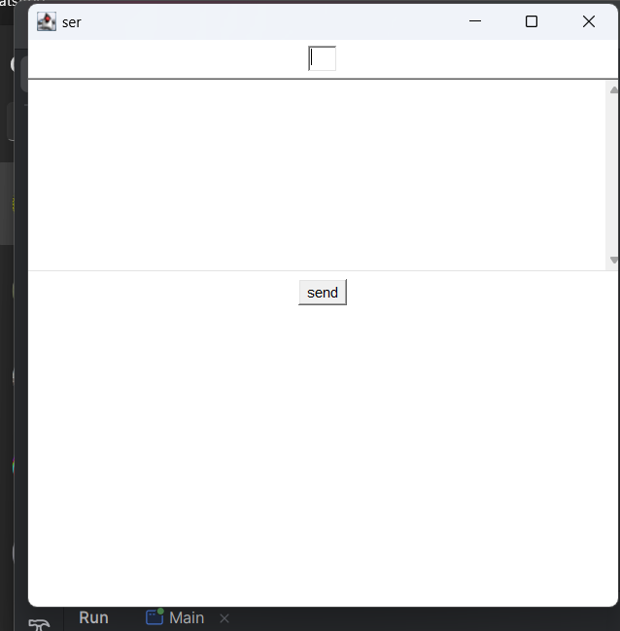
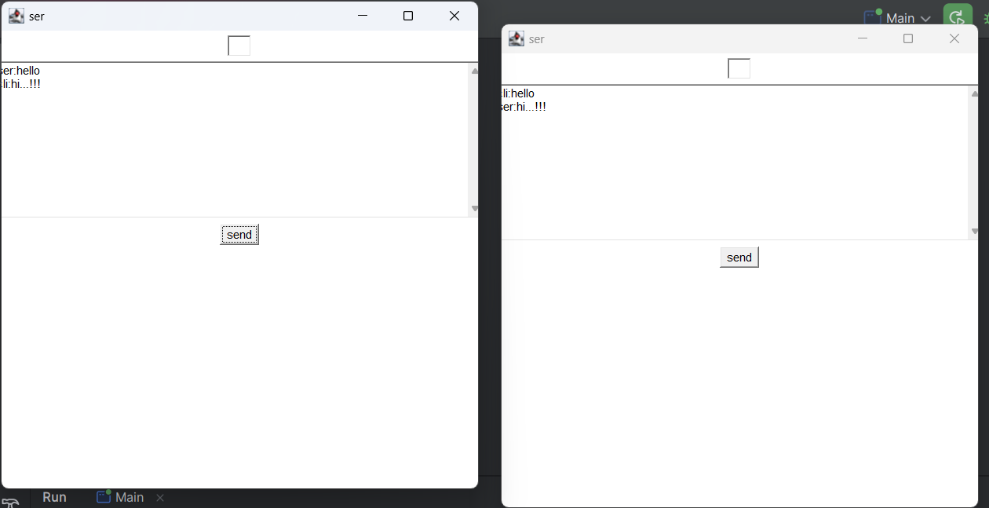
Results and Discussion

Slide 11
Queries
ANY QUERIS?

